Slide 1
Chapter 31
Security Protocols
in
the Internet

Slide 2
31.1 IP Level Security
Security Association
Two Modes
Two Security Protocols
Authentication Header (AH)
Encapsulating Security Payload (ESP)

Slide 3
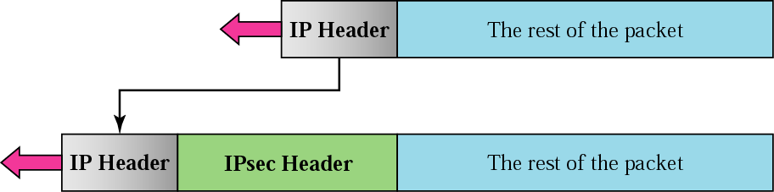
Figure 31.1 Transport mode

Slide 4
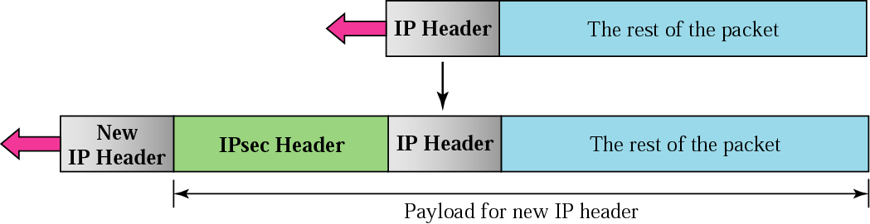
Figure 31.2 Tunnel mode

Slide 5
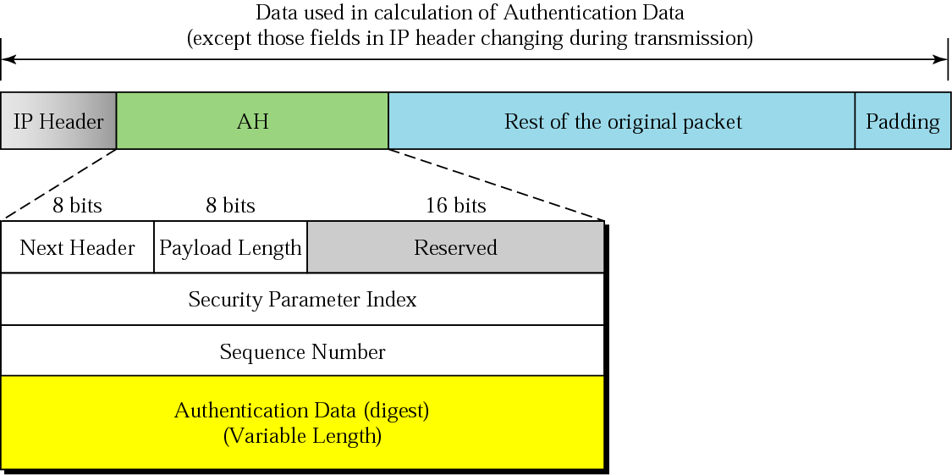
Figure 31.3 AH

Slide 6

Note:
The AH protocol provides source authentication and data integrity,
but not privacy.

Slide 7
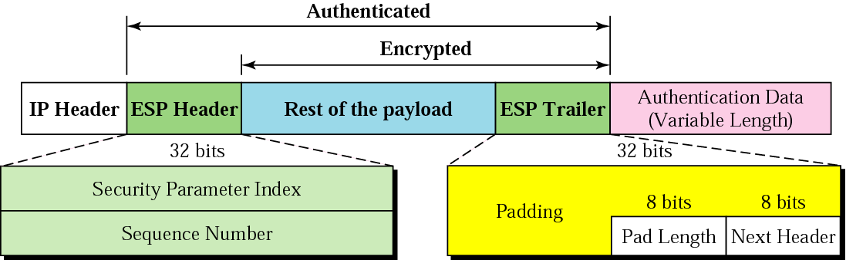
Figure 31.4 ESP

Slide 8
Note:
ESP provides source authentication, data integrity, and privacy.

Slide 9
31.2 Transport Layer Security
Position of TLS
Two Protocols

Slide 10
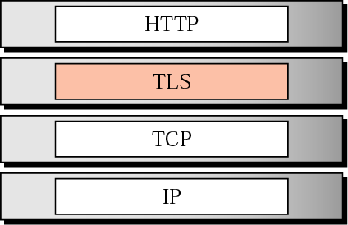
Figure 31.5 Position of TLS

Slide 11
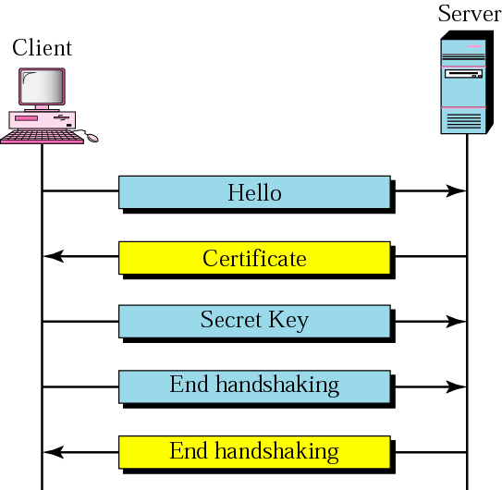
Figure 31.6 Handshake protocol

Slide 12
31.3 Application Layer Security
Pretty Good Privacy

Slide 13
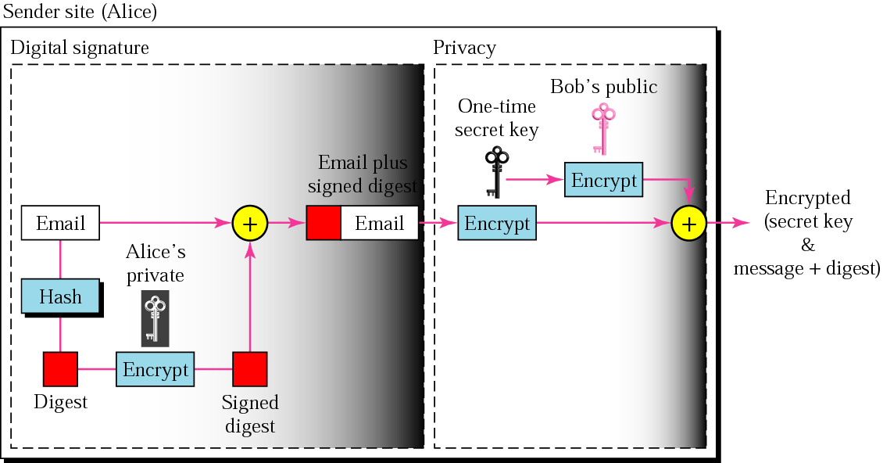
Figure 31.7 PGP at the sender site

Slide 14
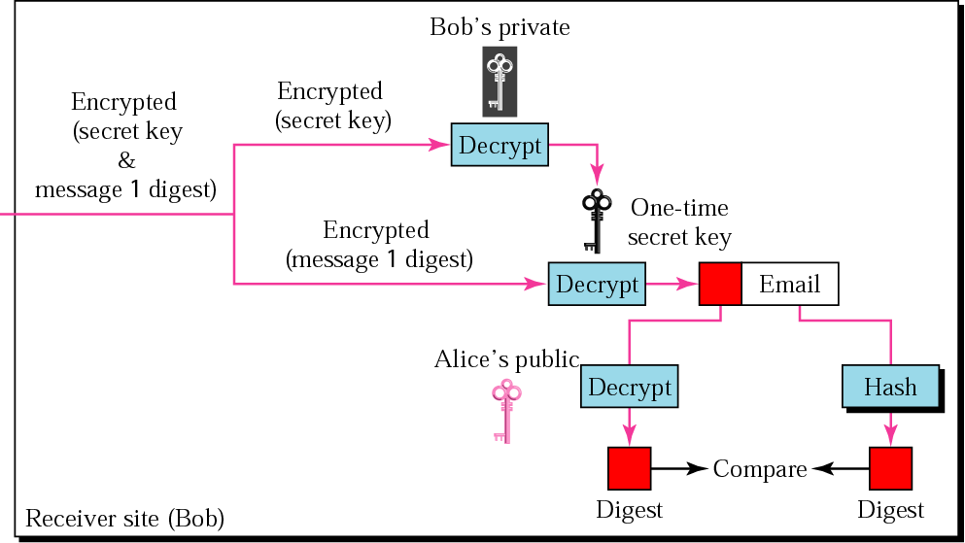
Figure 31.8 PGP at the receiver site

Slide 15
31.4 Firewalls
Packet-Filter Firewalls
Proxy Firewalls

Slide 16
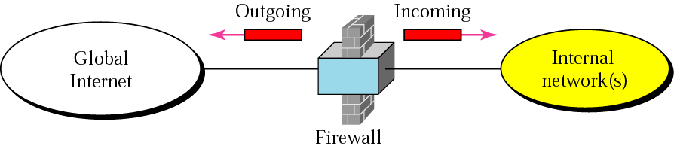
Figure 31.9 Firewall

Slide 17
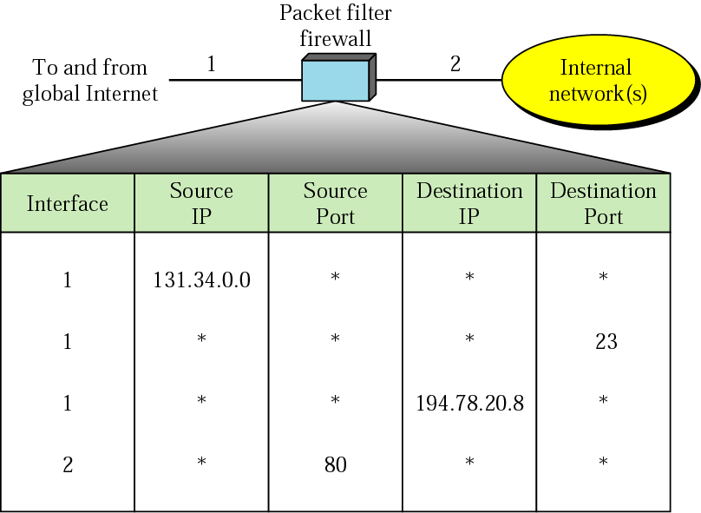
Figure 31.10 Packet-filter firewall

Slide 18
Note:
A packet-filter firewall filters at the network or transport layer.

Slide 19
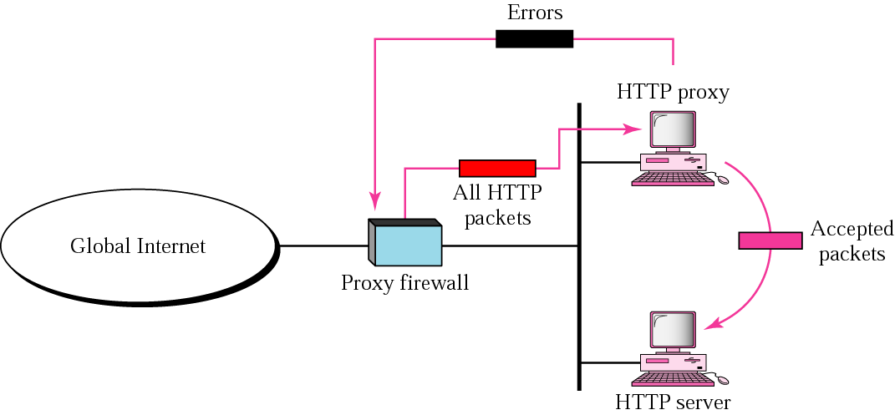
Figure 31.11 Proxy firewall

Slide 20
Note:
A proxy firewall filters at the application layer.

Slide 21
31. 5 Virtual Private Networks
Private Networks
Achieving Privacy
VPN Technology

Slide 22
Table 31.1 Addresses for private networks
Prefix | Range | Total
10/8 | 10.0.0.0 to 10.255.255.255 | 2²⁴
172.16/12 | 172.16.0.0 to 172.31.255.255 | 2²⁰
192.168/16 | 192.168.0.0 to 192.168.255.255 | 2¹⁶

Slide 23
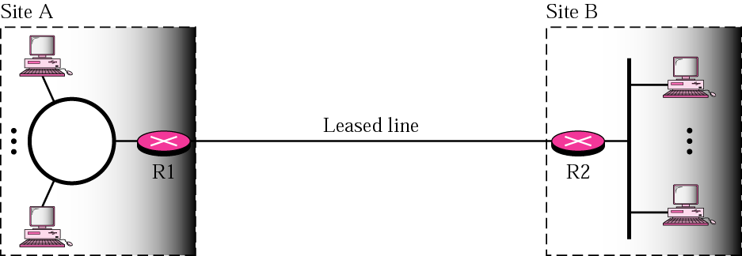
Figure 31.12 Private network

Slide 24
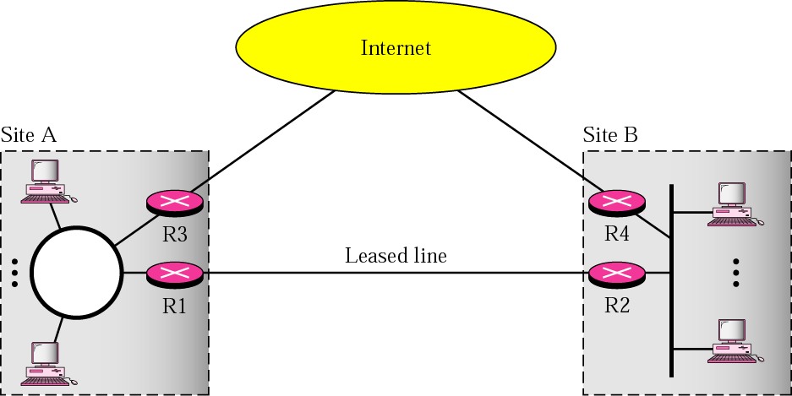
Figure 31.13 Hybrid network

Slide 25
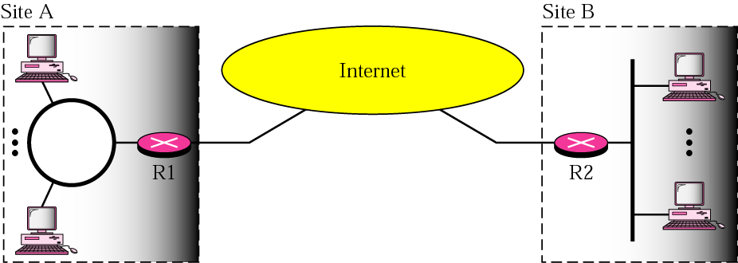
Figure 31.14 Virtual private network

Slide 26
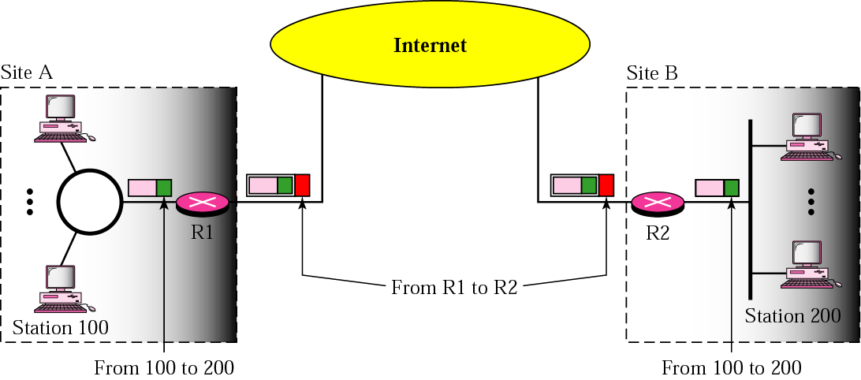
Figure 31.15 Addressing in a VPN

